Slide 1


7
Arrays
C# Programming: From Problem Analysis to Program Design
3rd Edition

Slide 2
Chapter Outline
Array Basics
Array as Method Parameter
Array as Return Type
Array in Classes
Array of Objects
Objects and Methods

Slide 3
1. Array Basics
General form of the array declaration:
<type> [ ] <identifier>;
Example:
int [] score;
double [] temperature;
These statements only declare the arrays with a name and type but do not create them

Slide 4
Array Basics
Arrays are objects of System.Array class
Array class includes methods and properties
We create an array in the same way we instantiate an object of a user-defined class
Use the new operator

Slide 5
Array Basics
General form for creating an array
new <type> [<size>]
<type> can be any predefined types like int or string, or a class that you create in C#
<size> is the number of elements
Example:
new int[14]
new double[7];

Slide 6
Array Basics
We need to assign the newly created array to an array variable
Example:
int [] score;
score = new int[14];
We can combine this into one statement
Example:
int [] score = new int[14];

Slide 7
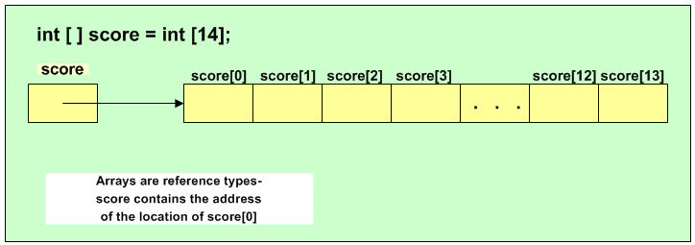
Array Basics
Should be new int [14];

Slide 8
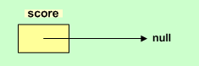
Array Basics
An array variable is a reference type variable
An array variable can be assigned to null if no array is created and assigned to it yet
Example:
int [] score;
score = null;

Slide 9
Array Initializers
Arrays can be initialized when they are created
Example:
int [] anArray = {100, 200, 400, 600};
char [] grade = {'A' , 'B' , 'C'};
double [] depth = {2.5, 3.0};
The length of the array is determined by the number of values inside the curly braces

Slide 10
Array Initializers (additional)
int [] anArray = {100, 200, 400, 600};
is equivalent to:
int [] anArray;
anArray = new int[4];
anArray[0] = 100;
anArray[1] = 200;
anArray[2] = 400;
anArray[3] = 600;

Slide 11
Array Access
Access array elements using an index enclosed in square brackets
score[0] = 100;
Arrays have a property called Length that tells us the size of the array
for (int i = 0; i < score.Length; i++)
score[i] = i;

Slide 12
Array Access
Note: if the array index is out of the range, a runtime error called IndexOutOfRangeException will be generated
Example:
for (int i = 0; i <= score.Length; i++)
score[i] = i;
Should be < not <=

Slide 13
Using foreach with Arrays
Used to iterate through an array
Read-only access
General format:
foreach (<type> <identifier> in <array>)
<statement>;

Slide 14
Using foreach with Arrays
Example:
string [ ] color = {"red", "green", "blue"};
foreach (string val in color)
Console.WriteLine (val);
is equivalent to:
string val;
for (int i = 0; i < color.Length; i++)
{
val = color[i];
Console.WriteLine (val);
}

Slide 15
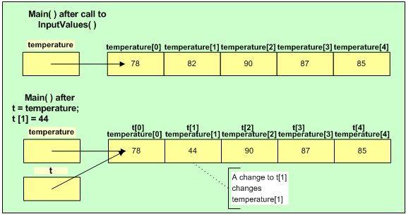
Array Assignment
temperature refers to array with following values
t = temperature;
Now temperature and t refer to same array

Slide 16
2. Array as Method Parameter
We can send arrays as arguments to methods
Method heading must include array as a parameter
General format:
<return type> <m-name> (<type> [ ] <param-name> ...)
Length or size of the array is not included
Example: method heading
void DisplayArrayContent(double[] anArray)

Slide 17
Array as Method Parameter
Arrays are reference variables
No copy is made of the contents
Call to the method sends the address of the array (not a copy of the array)
Example: method call
DisplayArrayContent(waterDepth);

Slide 18
Array Parameter Example
using System;
class TemperatureApp
{
static void Main( )
{
double [ ] temperature = new double[5];
InputValues(temperature);
Display(temperature);
}

Slide 19
Array Parameter Example
public static void InputValues(double[] temp)
{
string inValue;
for(int i = 0; i < temp.Length; i++)
{
Console.Write("Enter Temperature: ");
inValue = Console.ReadLine( );
temp[i] = Convert.ToDouble(inValue);
}
}

Slide 20
Array Parameter Example
public static void Display(double [] anArray)
{
Console.WriteLine("Temperature > 0: ");
foreach(double wVal in anArray)
{
if (wVal > 0)
Console.Write(wVal + " ");
}
Console.WriteLine();
}
}

Slide 21
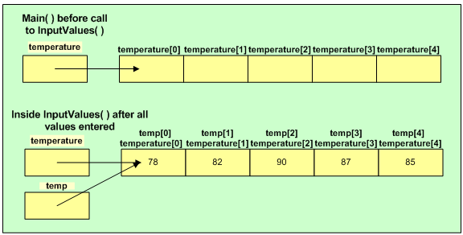
Array Parameter Example

Slide 22
3. Array as Return Type
Methods can have arrays as their return type
Example: method heading
public static int [ ] ReadScores()
Example: call to the method
int [ ] points;
points = ReadScores();
Method would include a return statement with an array

Slide 23
Additional: Array and Function Return Concept in C/C++
Data Area to store local variable(s)
The following program will not be compiled:
int main(void)
{
int a[3];
a = function1();
}
int[] function1()
{
int b[] = { 1, 2, 3 };
return b;
}
}
Main
a
function1
b
1
2
3
Note that the data area is created when the function starts its execution through a function call and destroyed when the function execution terminates.

Slide 24
Additional: Array and Function Return Concept in C#
Data Area to store local variable(s)
class Program
{
static void Main()
{
int [] a;
a = Method1();
foreach (int val in a)
Console.Write(val + "\t");
}
static int [] Method1()
{
int [] b = { 1, 2, 3 };
return b;
}
}
Main
Heap to store object(s)
a
1
2
3
Method1
b
Note that the data area is created when the method starts its execution through a method call and destroyed when the method execution terminates;
whereas objects are stored in Heap when they are created and referenced and destroyed when they are unreferenced.

Slide 25
4. Array in Classes
Arrays can be used as instance variables in classes
Example: instance variable declaration
private int[] pointsScored;
Normally array is created and assigned to instance variable in constructor
Example: in constructor
pointsScored = new int[size];

Slide 26
Array in Classes Example
class Player
{
private string name;
public string Name
{
get { return name; }
}
private int[] pointsScored;

Slide 27
Array in Classes Example
private int numberOfGames;
public int NumberOfGames
{
get { return numberOfGames; }
}
public Player(string aName, int gamesPlayed)
{
name = aName;
numberOfGames = gamesPlayed;
pointsScored = new int[numberOfGames];
}

Slide 28
Array in Classes Example
public void FillScores(int[] scores)
{
for (int i=0; i < pointsScored.Length; i++)
pointsScored[i] = scores[i];
}
public double GetAverage()
{
double total = 0.0;
double average;

Slide 29
Array in Classes Example
if (pointsScored.Length > 0) {
foreach(int s in pointsScored)
total += s;
average = total / numberOfGames;
}
else
average = 0.0;
return average;
}
}

Slide 30
Array in Classes Example
using System;
class PlayerTest
{
static void Main()
{
Player p = new Player("Jordan", 3);
int[] scores = {5, 12, 3};
p.FillScores(scores);

Slide 31
Array in Classes Example
Console.WriteLine("Average is {0:F0}",
p.GetAverage());
}
}

Slide 32
1. Array of Objects
Just as you can create an array of int or an array of double, you create an array of objects
Example:
Suppose we have 12 players
We can create an array of Player objects to represent the 12 players

Slide 33
Array of Objects
Example:
Player [ ] teamMember = new Player[12];
Note: this just creates the array, not the Player objects
We must create each Player object and assign it into the array
Example:
teamMember[0] = new Player("Jordan", 3);

Slide 34
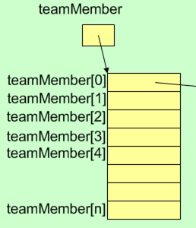
Array of Objects
Player Object
null
name
Jordan
null
numberofGames
3
null
pointsScored
5
12
3
null
null
null
null

Slide 35
Array of Objects Example
class Car
{
private string regNumber;
public string RegNumber
{
get { return regNumber; }
}
public Car(string number)
{
regNumber = number;
}
}

Slide 36
Array of Objects Example
using System;
class CarArray
{
static void Main()
{
Car[] cars = new Car[10];
Car c1 = new Car("ABC1234");
cars[0] = c1;
cars[1] = new Car("ABC5678");
cars[2] = new Car("ABC9999");

Slide 37
Array of Objects Example
// Display car details - version 1
for (int i = 0; i < cars.Length; i++)
{
if (cars[i] != null)
{
Car c = cars[i];
Console.WriteLine(c.RegNumber);
}
}

Slide 38
Array of Objects Example
// Display car details – version 2
for (int i = 0; i < cars.Length; i++)
{
if (cars[i] != null)
Console.WriteLine(cars[i].RegNumber);
}

Slide 39
Array of Objects Example
// Display car details - version 3
foreach (Car c in cars)
{
if (c != null)
Console.WriteLine(c.RegNumber);
}
}
}

Slide 40
2. Objects and Methods
Just as a method can return an array, a method may also return an object
The method would include a return statement with the object
Example: method heading
public static Car GetCarInfo()
Example: call to the method
Car car = GetCarInfo();

Slide 41
Objects and Methods
Similarly, just as we can send an array as an argument to a method, we can send an object
Example: method heading
static void DisplayCarInfo(Car aCar)
Example: call to method
Car car = new Car("ABC1234");
DisplayCarInfo(car);

Slide 42
Objects and Methods Example
using System;
class CarApp
{
public static void Main()
{
Console.Write("How many cars? ");
string inValue = Console.ReadLine();
int count = Convert.ToInt32(inValue);
Car[] cars = new Car[count];

Slide 43
Objects and Methods Example
for (int i = 0; i < count; i++)
{
Console.WriteLine("Car {0}:", i+1);
Car car = GetCarInfo();
cars[i] = car;
}
for (int i = 0; i < count; i++)
{
Car car = cars[i];
DisplayCarInfo(car);
}
}

Slide 44
Objects and Methods Example
public static Car GetCarInfo()
{
Console.Write("Enter reg. number: ");
string number = Console.ReadLine();
Car c = new Car(number);
return c;
}
public static void DisplayCarInfo(Car car)
{
Console.WriteLine(car.RegNumber);
}
}

